Slide 1


Introduction to Data Science
Mohammed El-Agha
Software Developer & Data Science Specialist

Slide 2

Outline
What’s Data?
What’s Data Science?
Data Science Tasks
How to Work in Data Science?

Slide 3
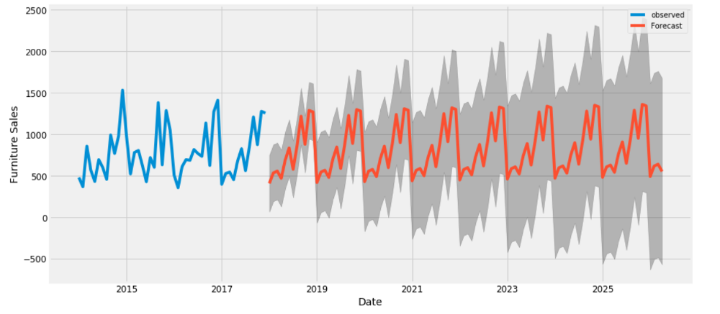
What’s Data

Slide 4
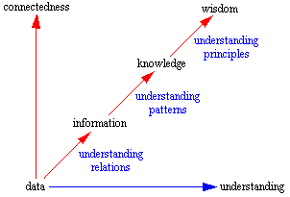
What’s Data

Slide 5
What’s Data
Data are sets of signs that represent empirical stimuli or perceptions
information is a set of signs, which represent empirical knowledge
knowledge is a set of signs that represent the meaning (or the content) of thoughts that the individual justifiably believes that they are true
Wisdom is the ability to use your knowledge and experience to make good decisions and judgments

Slide 6
What’s Data
Data represents a fact or statement of event without relation to other things
Information embodies the understanding of a relationship of some sort, possibly cause and effect
Knowledge represents a pattern that connects and generally provides a high level of predictability as to what is described or what will happen next
Wisdom embodies more of an understanding of fundamental principles embodied within the knowledge that are essentially the basis for the knowledge being what it is. Wisdom is essentially systemic

Slide 7
What’s Data
It is raining
The temperature dropped 15 degrees and then it started raining
If the humidity is very high and the temperature drops substantially the atmospheres is often unlikely to be able to hold the moisture so it rains
It rains because it rains. And this encompasses an understanding of all the interactions that happen between raining, evaporation, air currents, temperature gradients, changes, and raining

Slide 8
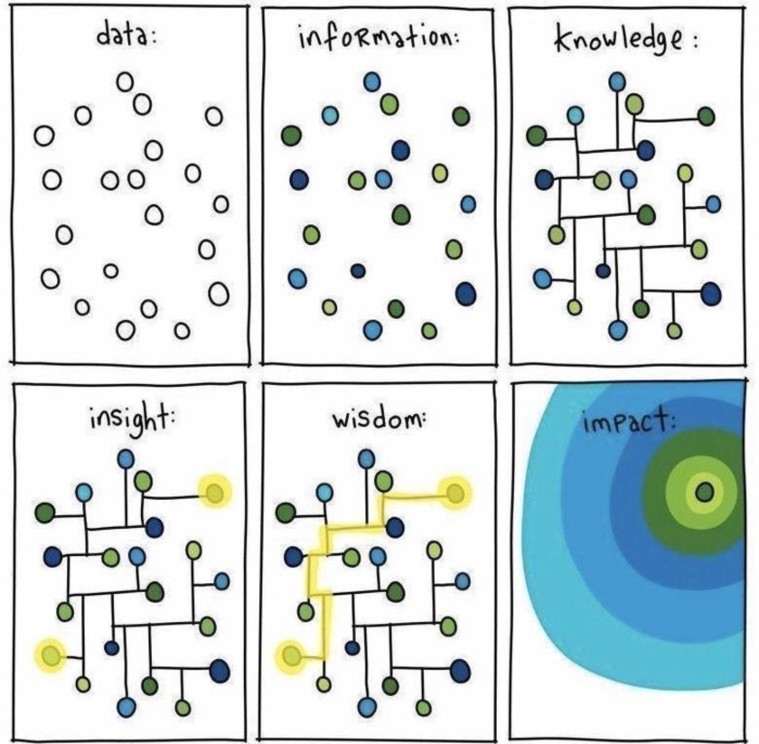
What’s Data

Slide 9
What’s Data
Data Product is digital information can be purchased.
Data Product is a software
Utilize input data
Process and handle it
Retrieve a useful, meaningful output
Which algorithmically-generated

Slide 10
What’s Data
Data Product examples:
YouTude recommendation system
Amazon recommendation system
Gmail’s spam filter
Sales forecasting

Slide 11
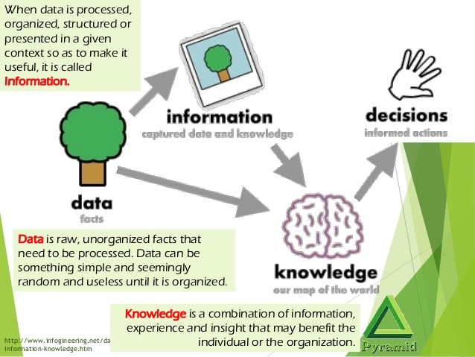
What’s Data Science

Slide 12
What’s Data Science
Data Science extremely intersect with Statistics
Data Science is a science which uses Computer Science to automatically apply models, methods and approaches of Statistics, Data Analysis, Visualization and Decision-Making; by a complete process of collecting, cleaning, integrating, analyzing, visualizing and interacting data; to create data product

Slide 13
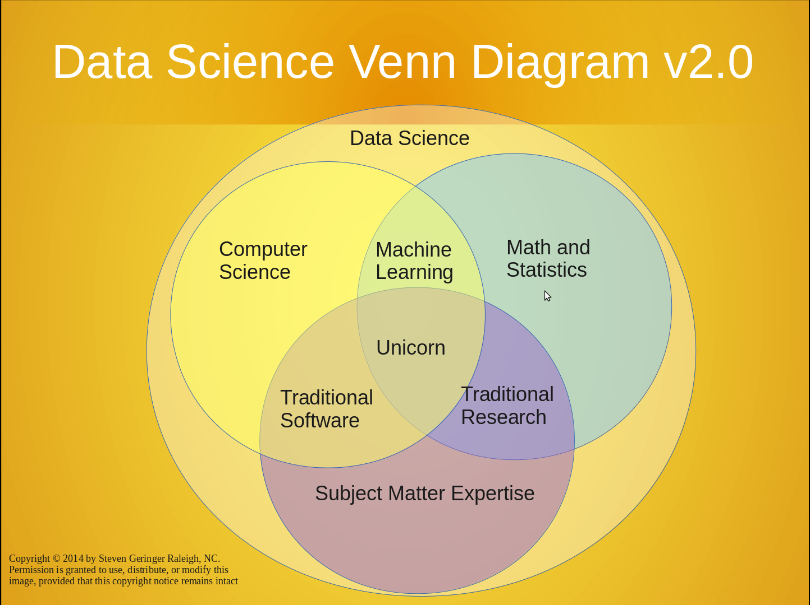
What’s Data Science

Slide 14
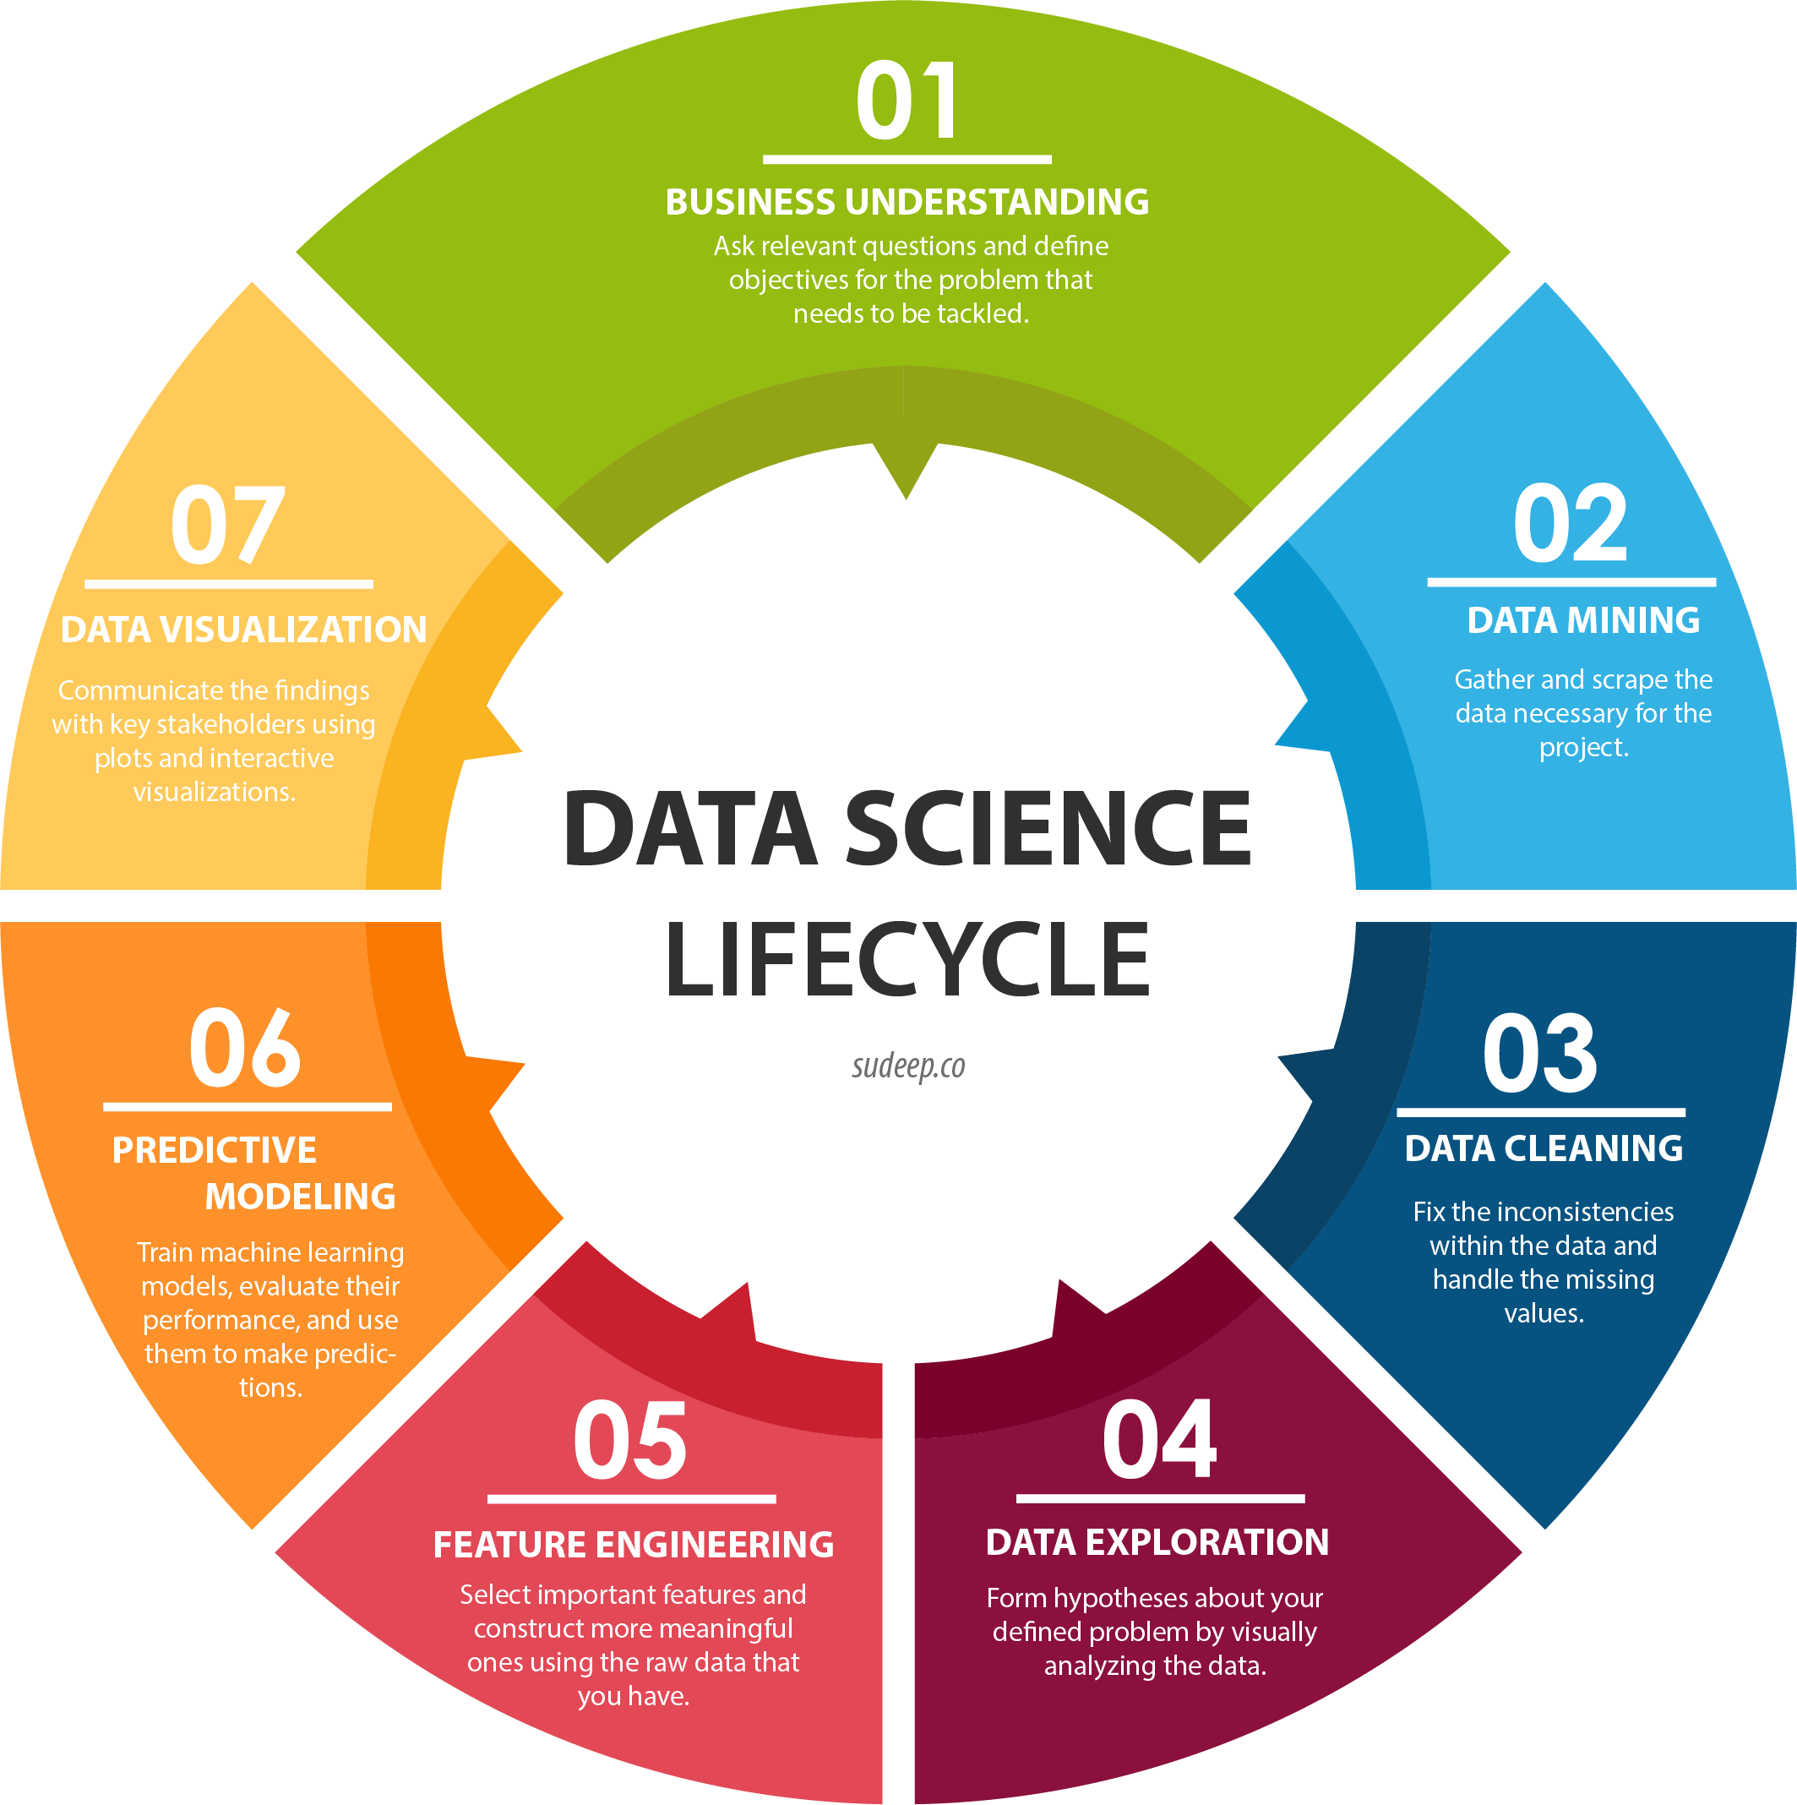
What’s Data Science

Slide 15
Data Science Tasks
In general Data Science tasks can be classified into two categories:
Descriptive tasks characterize the general properties of the data.
Predictive tasks perform deduction on the current data in order to make predictions.

Slide 16
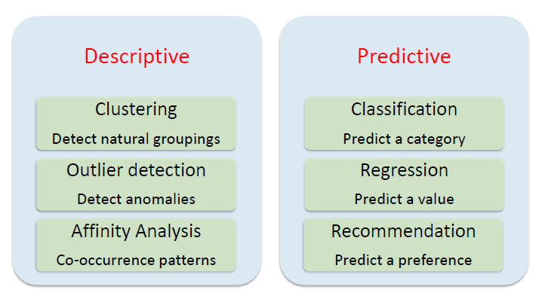
Data Science Tasks

Slide 17
Data Science Tasks
We typically use data science to answer five types of questions:
How much or how many? (regression)
Which category? (classification)
Which group? (clustering)
Is this weird? (anomaly detection)
Which option should be taken? (recommendation)

Slide 18
Data Science Tools
Scripting/Programming Languages: R, Python
Applications: Excel
Software Tools: RapidMiner, Weka, Orange
Storage: MySQL, PostgresSQL, MongoDB
Processing Tools: Hadoop, Spark

Slide 19
Any Questions

Slide 20
Thank You!
Mohammed El-Agha
Data Science Instructor

